Slide 1
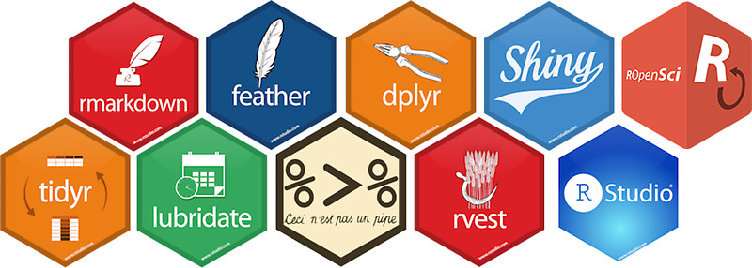
Using R as a Research Tool.
NERC E4 DTP Training
Dr Susan Johnston, Institute of Ecology and Evolution

Slide 2
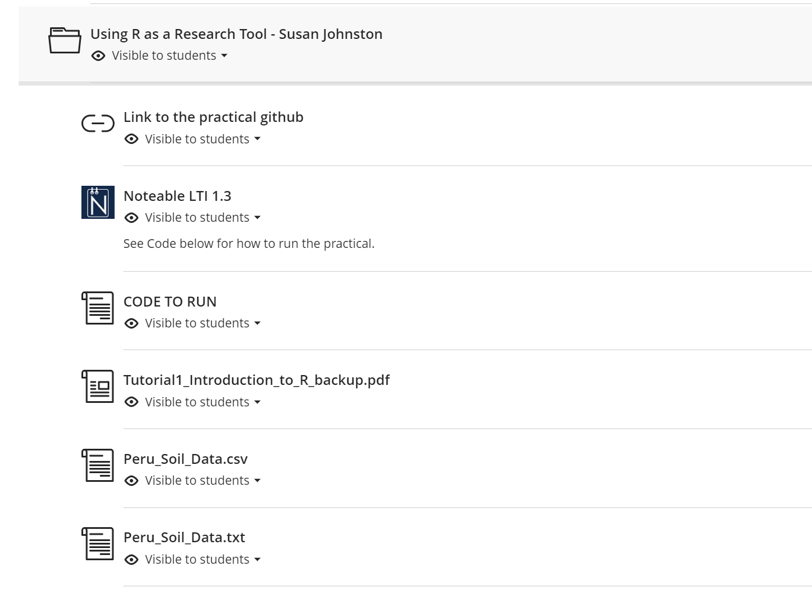
github.com/susjoh/E4StatsTutorials

Slide 3
Life of a research project - expectation.
Research Question
Data
Visualisation and Analysis
Writing
Publish

Slide 4
Life of a research project - reality.
Finally happy
Oh a cool new method came out, we need to use it
Research Question based on some previous weird result
Edit code and test on data with a new script
Manuscript_new_v6_usethisone
Analysis_real_updated_11111
Eventually submit to journal
Collect data
And/or inherit dodgy dataset in excel spreadsheet with some unannotated code from previous student
Start writing and realise you made some bad decisions
BTW the Journal requires raw data
Write code to analyse data
Also we need all the scripts you wrote
Clean the data
Reviewer 2: OMG this model is terrible, why not that model, and also please collect this extra data
FINALLY ACCEPTED
Find some random problem with the data that needs fixed
New research Question based on your weird result
Other researchers: what beautiful methods, lets use it for our research

Slide 5

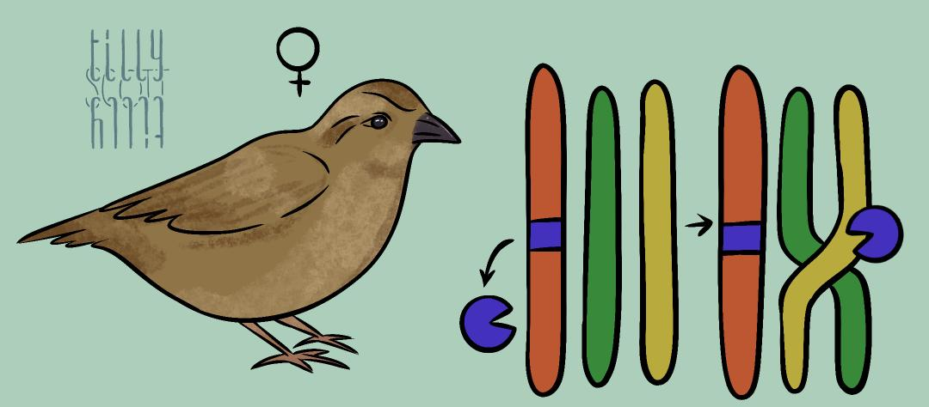
Science is not a solo endeavour!
Bernt-Erik
- NEW DATA
- RESULTS
- MANUSCRIPT
- CODE
Henrik
PHENOTYPE & GENOMIC DATA
Thor Harald
John
Arild
Hamish
Gabriel
Ingerid
Alina
SUPERVISION & FUNDING
CODE
Kenneth
Susan
Stefanie
DATA & CODE
ANALYSIS
ANALYSIS
SOFTWARE
Anna
Cathrine
Bertrand
Lucy
Homa

Slide 6
We need to be good scientists and good collaborators…
Organised data and workflows.
Reproducible analyses.
Code availability.
Version control.

Slide 7
What is reproducible research?
“Reproducibility is the ability of an entire experiment or study to be reproduced, either by the researcher or by someone else working independently, [and] is one of the main principles of the scientific method.‘’
-Wikipedia

Slide 8
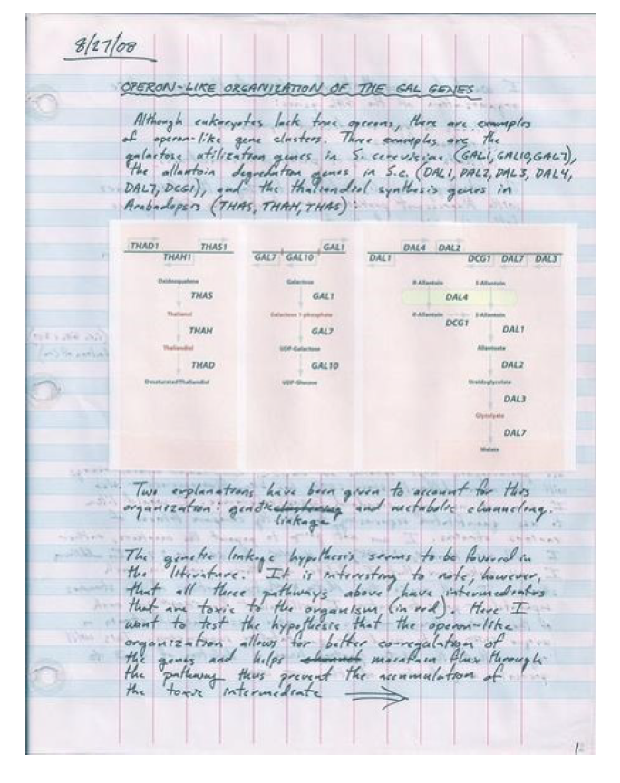
In the lab…

Slide 9
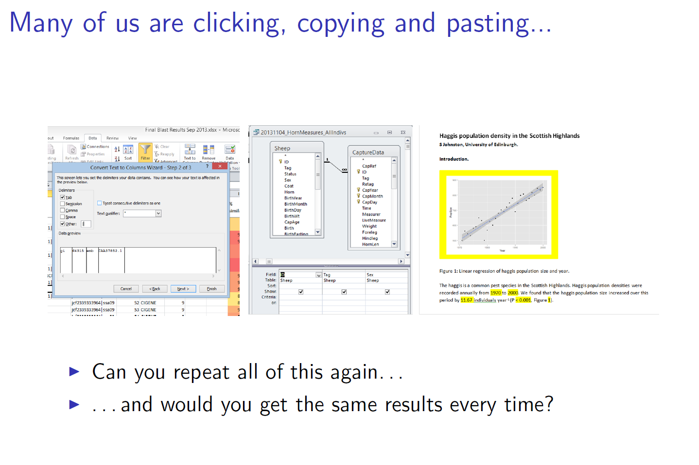

Slide 10
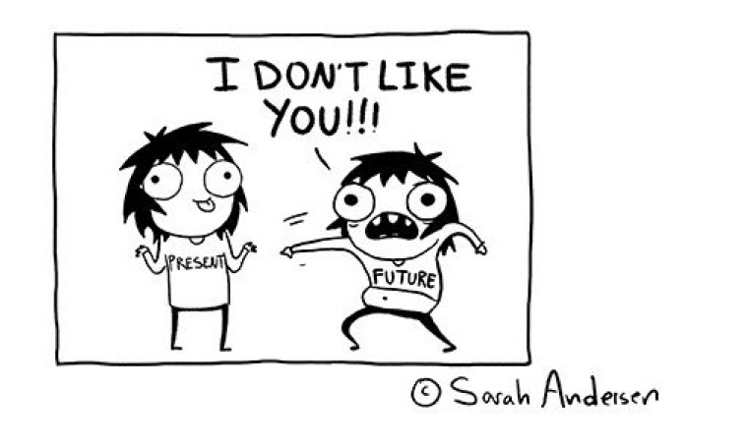
Scenarios that benefit from reproducibility
The first researcher who will need to reproduce results is likely to be YOU.
New data becomes available.
You return to a project after a period of time.
You give the project to a new student/collaborator.
A reviewer wants you to change something.
Other researchers want to used your data/methods.
You found an error, but not sure how it happened.

Slide 11
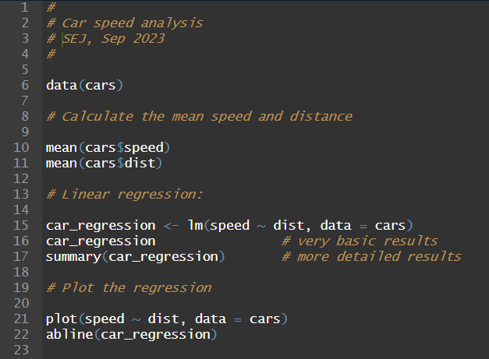
Coding is Key!
“This is R. There is no if. Only how.”
-- Simon `Yoda' Blomberg, R-help (April 2005)
Automates analyses.
Provides a record of all data manipulation analysis.
Can be adapted and rerun.
You should always use code whenever possible.

Slide 12
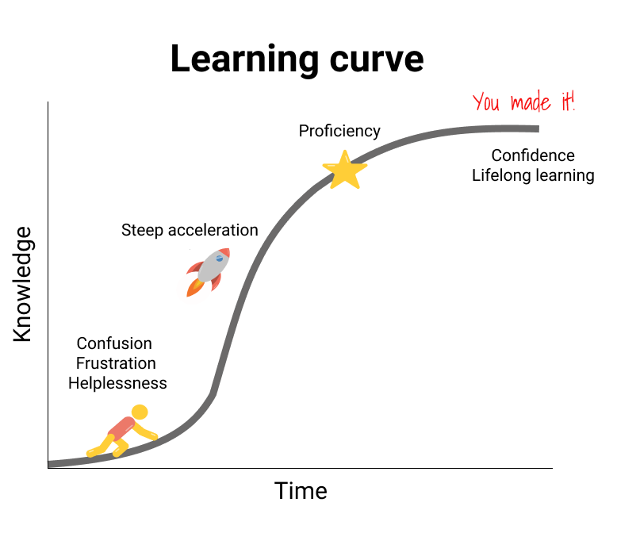
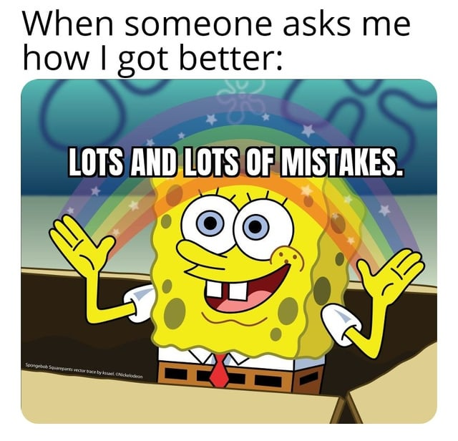
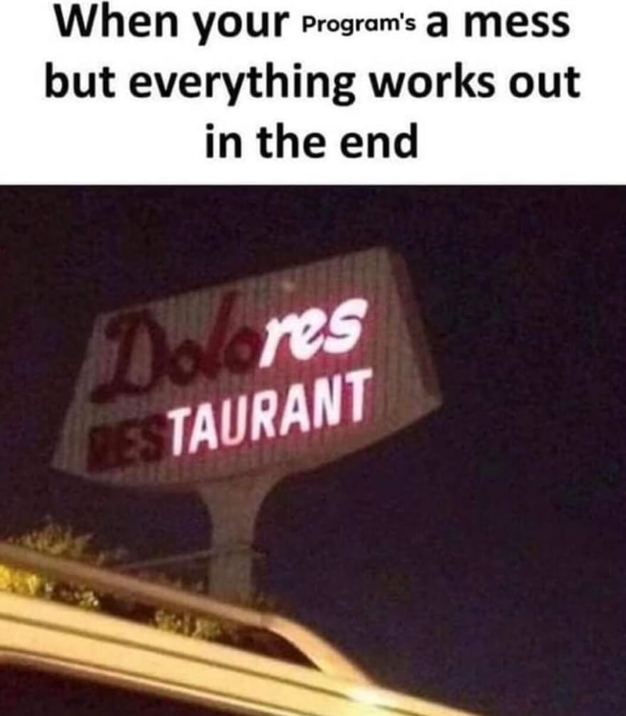
Learning to code is about the ✨process✨
It will take time (but not much time!)
You will (should) screw up (a lot) and learn many lessons.
Code can be improved: it’s fine to get the job done.

Slide 13
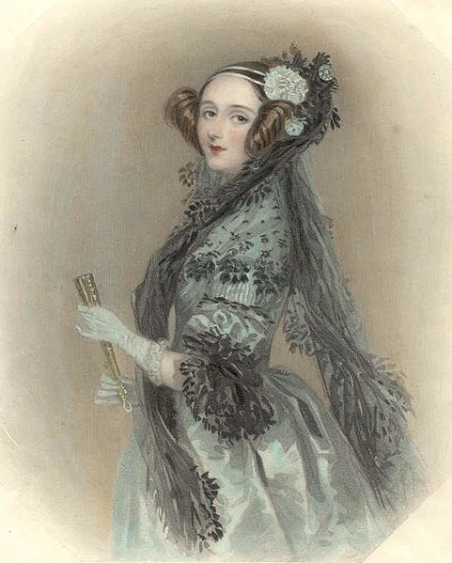
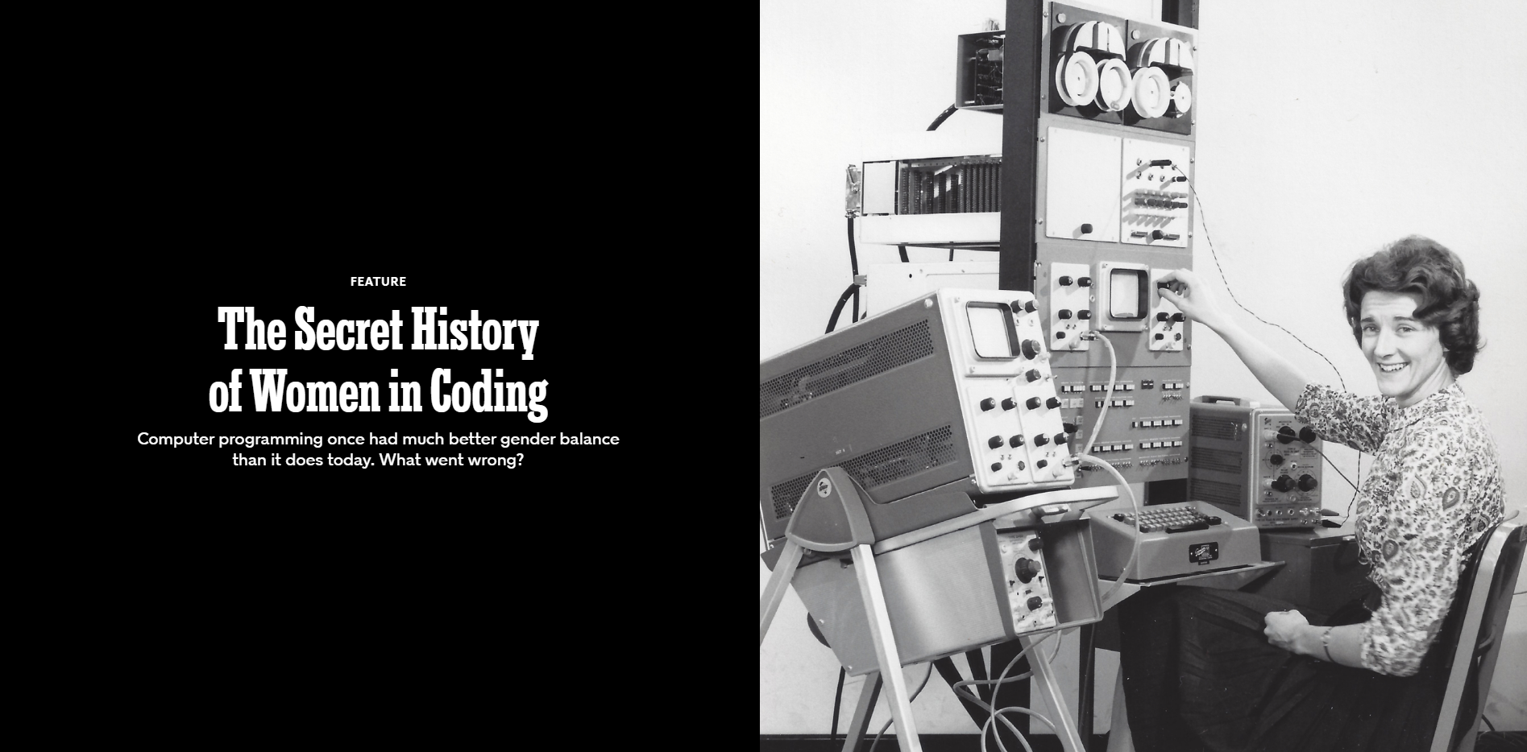
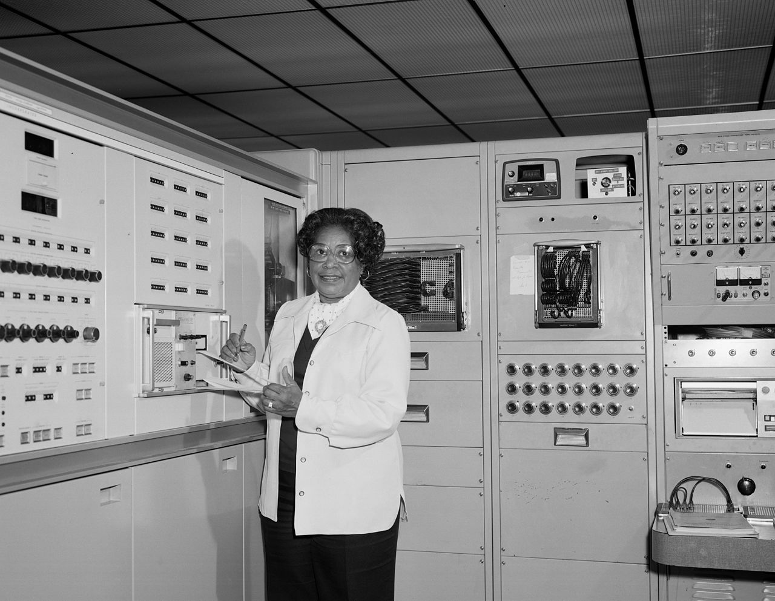
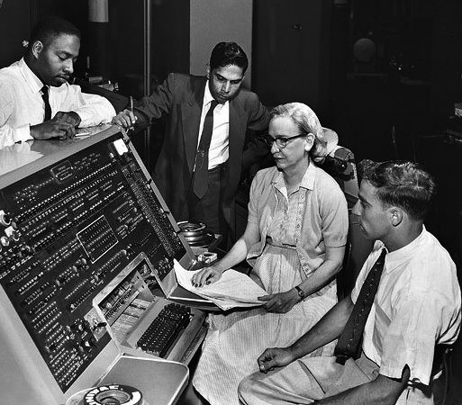
Anyone can code.
https://www.nytimes.com/2019/02/13/magazine/women-coding-computer-programming.html
Ada Lovelace, 1840
Mary Jackson at NASA, 1977
Rear Admiral Grace Hopper, 1960
Notes:
chiefly known for her work on Charles Babbage's proposed mechanical general-purpose computer, the Analytical Engine. She is believed by some to be the first to recognise that the machine had applications beyond pure calculation, and to have published the first algorithm intended to be carried out by such a machine. As a result, she is often regarded as the first to recognise the full potential of computers and as one of the first to be a computer programmer.

Slide 14


What is ?
What is ?
Environment for statistical computing and graphics.
Interactive programming language.
20,406 packages on CRAN.
Free and open-source multi-platform software.
Integrated development environment (IDE) for running R.
Integrates other tools to aid reproducibility.
R Projects allow portability.
Free multi-platform software.

Slide 15
Why use ?
“This is R. There is no if. Only how.”
-- Simon `Yoda' Blomberg, R-help (April 2005)
Statistics.
Processing and tidying data.
Data visualisation.
Reports and presentations.
Interactive web applications.
Portable projects.

Slide 16
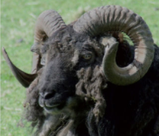
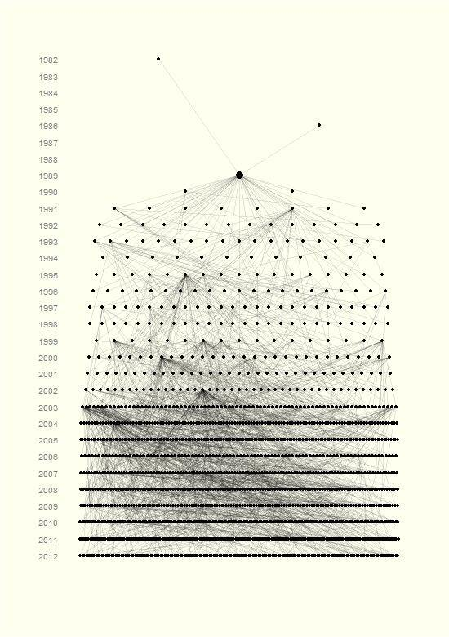
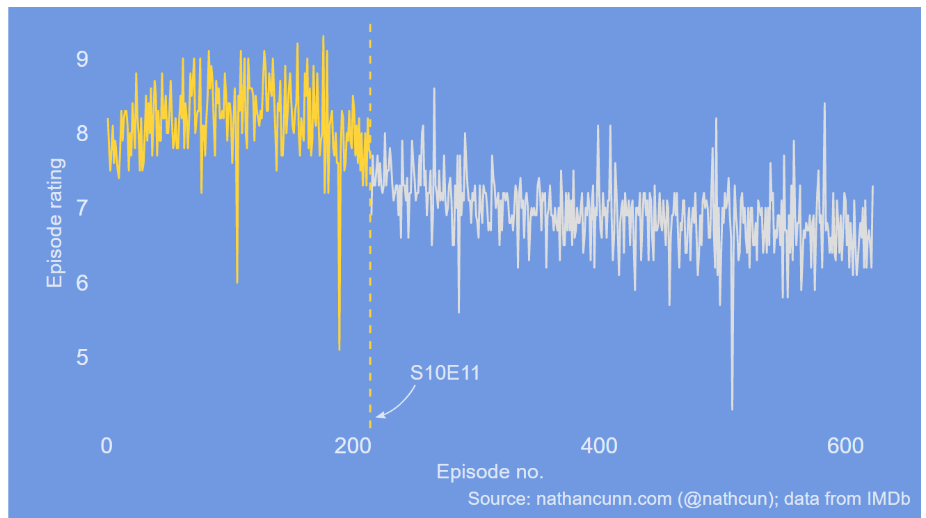
Data visualisation e.g. http://www.r-graph-gallery.com/portfolio/ggplot2-package/
When did the golden age of The Simpsons end?
Ancestors and descendants of a single Soay sheep called Snowball.

Slide 17
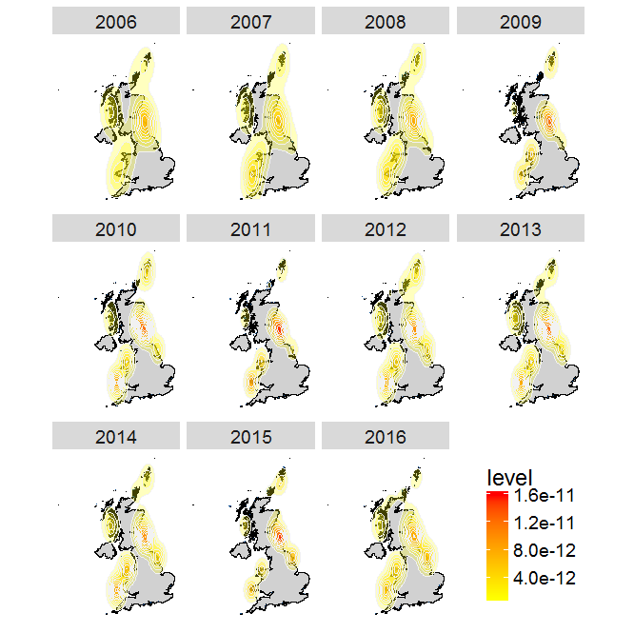


UK distribution of Atlantic Puffins
Access data from the Global Biodiversity Information Facility
And Flickr directly through R
Team Shrub in School of Geosciences:
https://ourcodingclub.github.io/tutorials/seecc_1/index.html

Slide 18
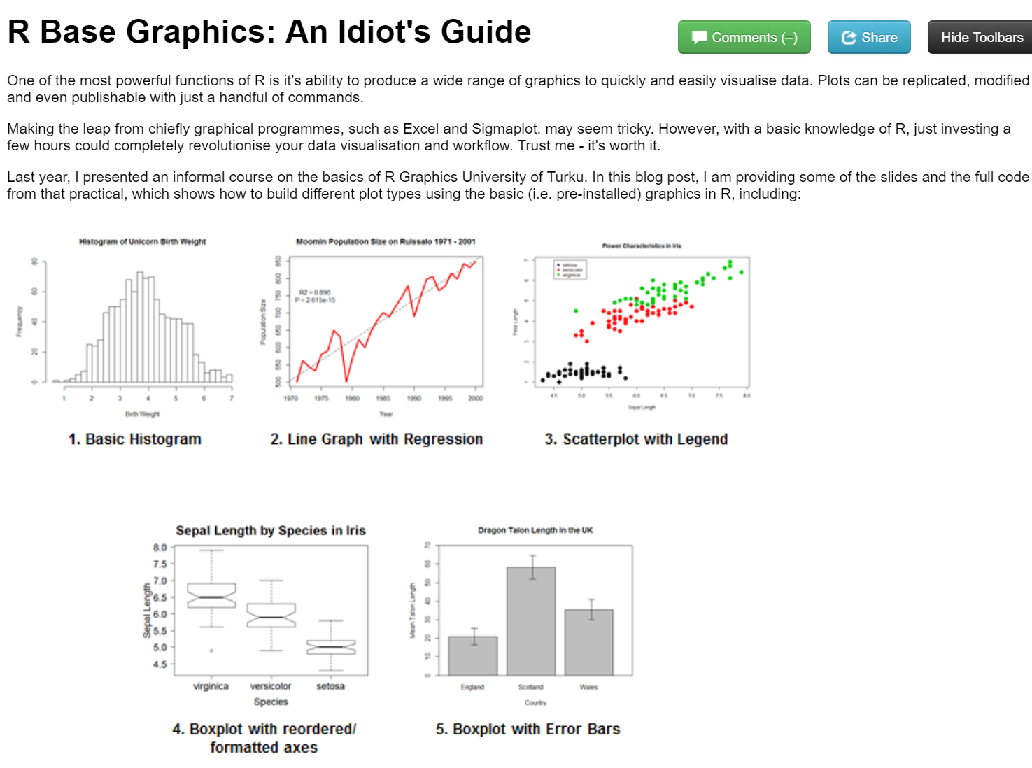
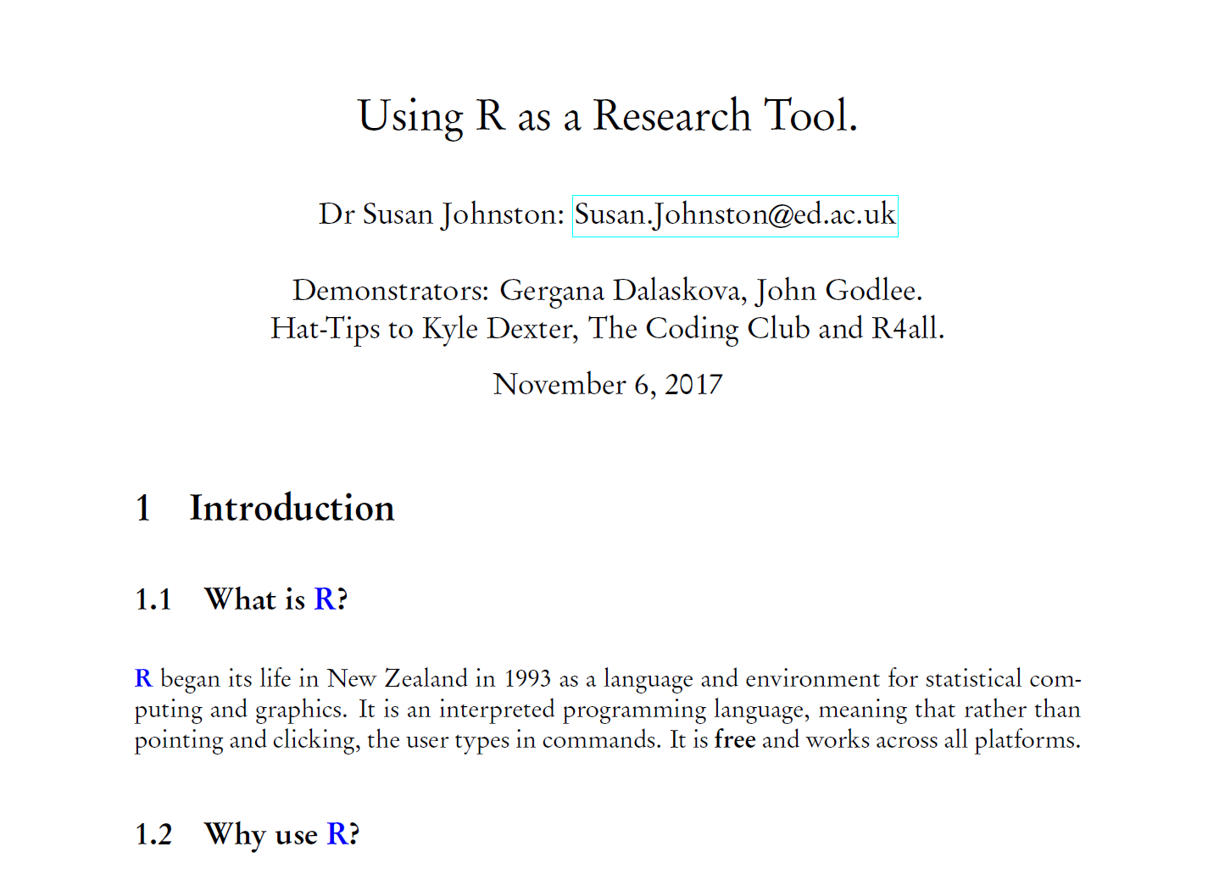
Report writing
knitr to HTML
LaTeX and R Sweave

Slide 19
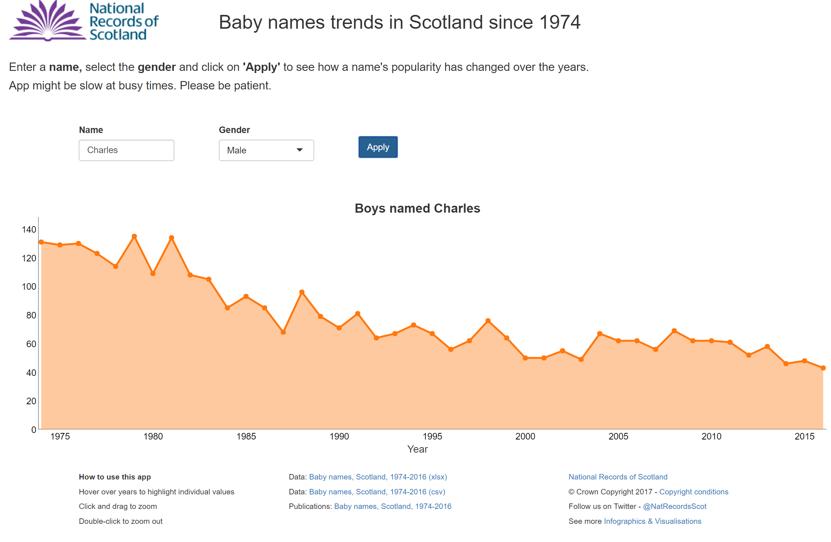
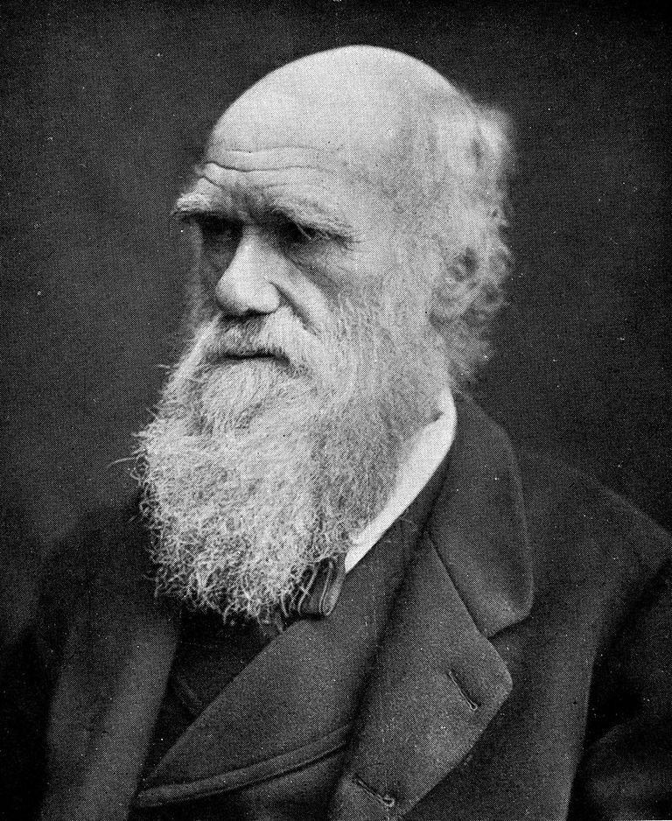
Interactive applications (shiny)
https://scotland.shinyapps.io/babynames/

Slide 20

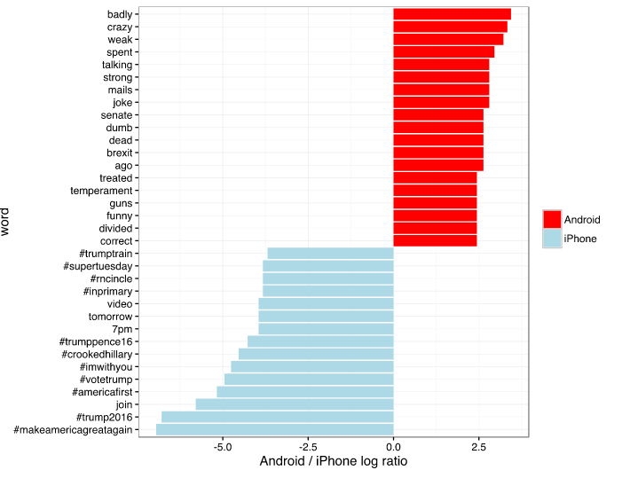
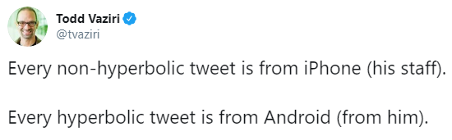
Analytics e.g.
http://varianceexplained.org/r/trump-tweets/

Slide 21
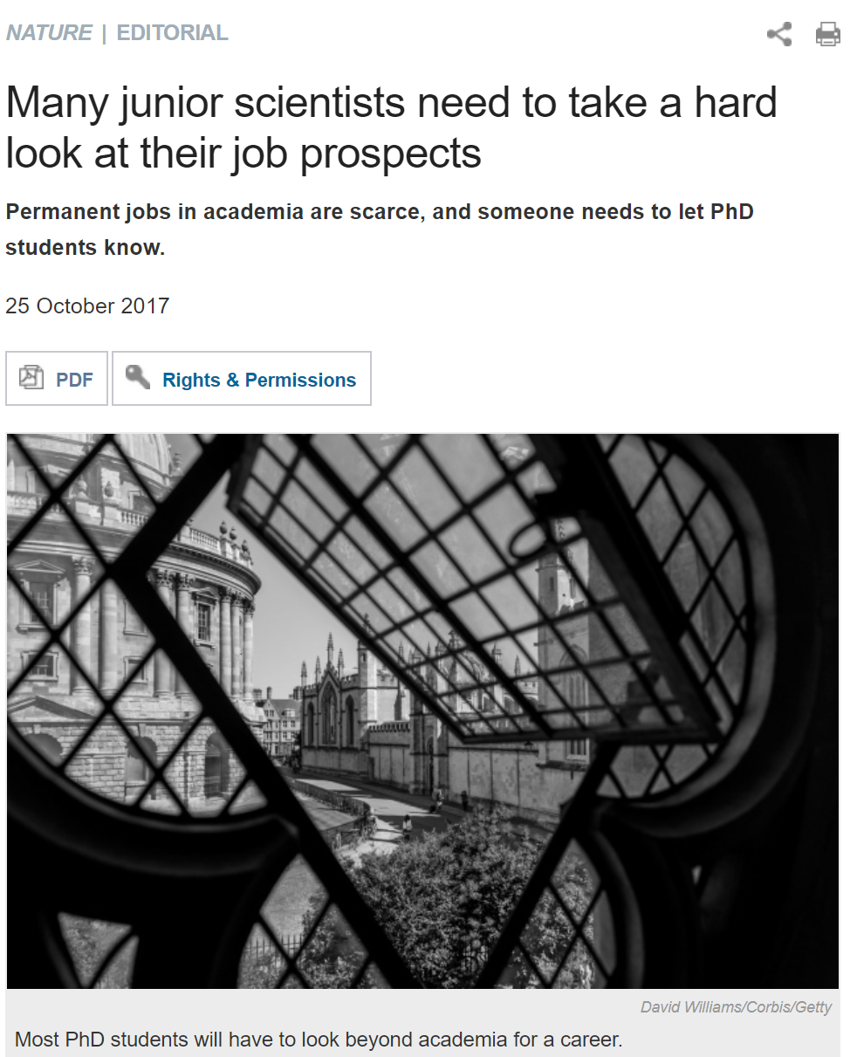
Programmers are in demand.
Transferable skill which makes you competitive for postdocs and academic positions.
Similar to Python and easy path to other languages.
Research companies, Facebook, Google, Twitter, AirBnB.
Scotland R jobs at Scottish Government, Met Office, JP Morgan, RBS & other Banks, Rockstar North, University of Edinburgh, Energy Companies, start-ups, etc.
https://www.nature.com/news/many-junior-scientists-need-to-take-a-hard-look-at-their-job-prospects-1.22879

Slide 22
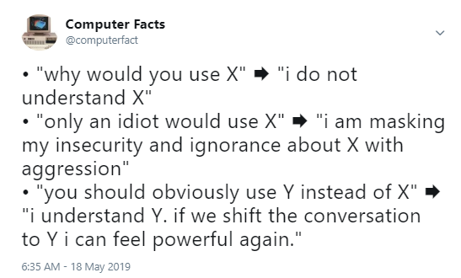
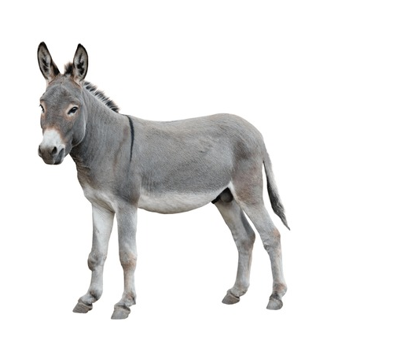
But I don’t need to learn X!
Best method is implemented in X.
Collaborator uses X.
Future employer uses X.
Your life could be improved by using X.

Slide 23
Life of a research project.
Research Question
Create & Structure an R Project
Embed code, figures and results in R Markdown
Statistical tests on research data
Data
Visualisation
Analysis
Writing
Loading & managing data
with dplyr
Data visualisation with ggplot2
Let’s talk about the process (github & journals)
Publish

Slide 24
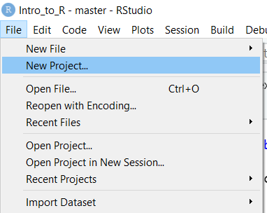
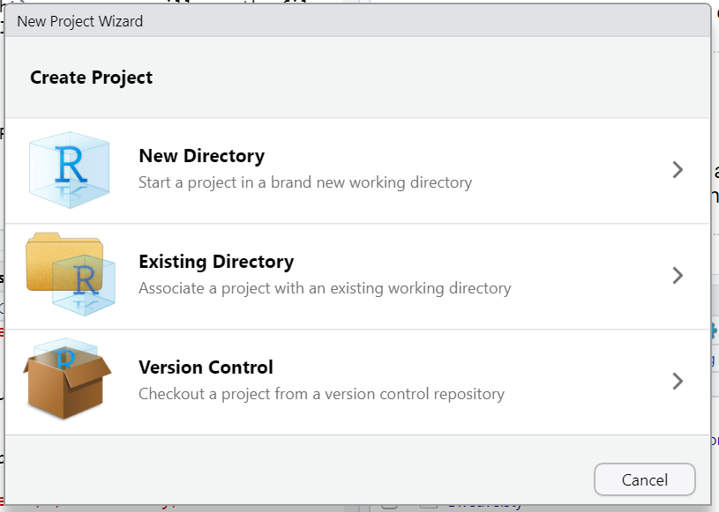
Using R Projects.
Establishes a folder with an associated .Rproj
One folder, one portable project.
Saves history, profile, etc.
Allows version control within R Studio (e.g. git)

Slide 25
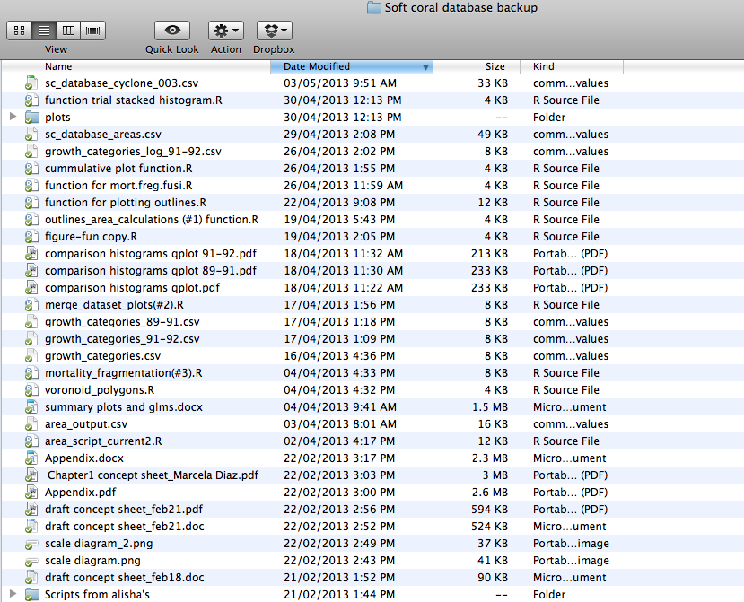
Structuring an R Project.
https://nicercode.github.io/blog/2013-05-17-organising-my-project/
https://nicercode.github.io/blog/2013-04-05-projects/

Slide 26
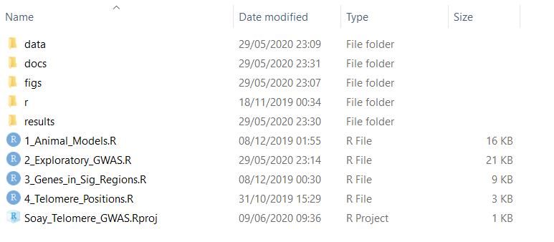
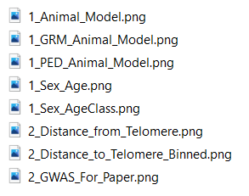
All data, scripts and output should be kept within the same project directory (where possible).
Keep data here (read only)
Keep manuscript and reports here
Save figures here
Save results here
Notes:
•Start your analysis from copies of your raw data.
•Any cleaning, merging, transforming, etc. of data should be done in scripts,
not manually.
•Split your workflow (scripts) into logical thematic units. For example, you might
separate your code into scripts that (i) load, merge and clean data, (ii) analyse
data, and (iii) produce outputs like figures and tables.
•Eliminate code duplication by packaging up useful code into custom functions
(see Programming). Make sure to comment your functions thoroughly,
explaining their expected inputs and outputs, and what they are doing and why.
•Document your code and data as comments in your scripts or by producing
separate documentation (see Programming and Reproducible reports).
•Any intermediary outputs generated by your workflow should be kept separate
from raw data.

Slide 27
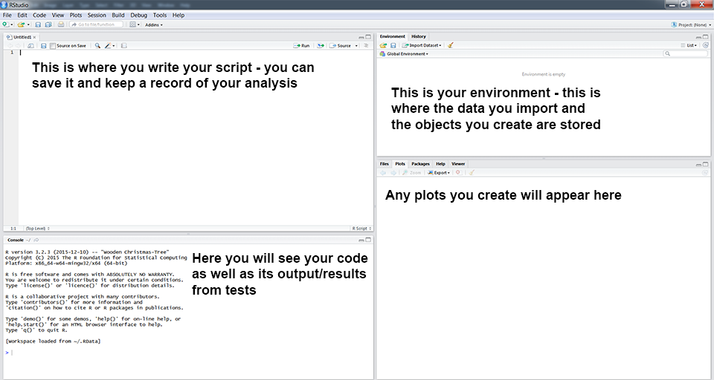
R and the Rstudio Environment
https://ourcodingclub.github.io/tutorials/intro-to-r/

Slide 28
Finding help.
In R…
? searches for a specific function.
?? searches for a specific string.
Help tab in RStudio
Online…
ourcodingclub.github.io
Stack Overflow
R Cheatsheets

Slide 29
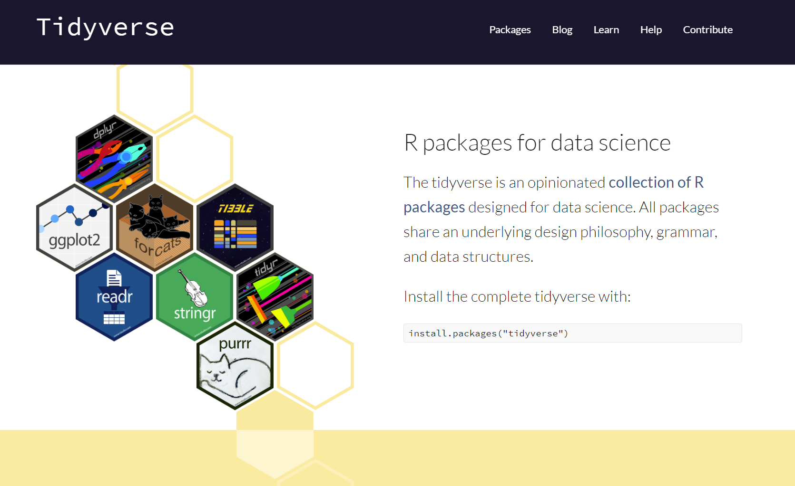

Slide 30
Loading data into R

Slide 31
Data management in R with base R & dplyr
Summarise data with summary()
Sort data with arrange()
Select columns with select()
Adding columns with $
Select rows with filter()

Slide 32
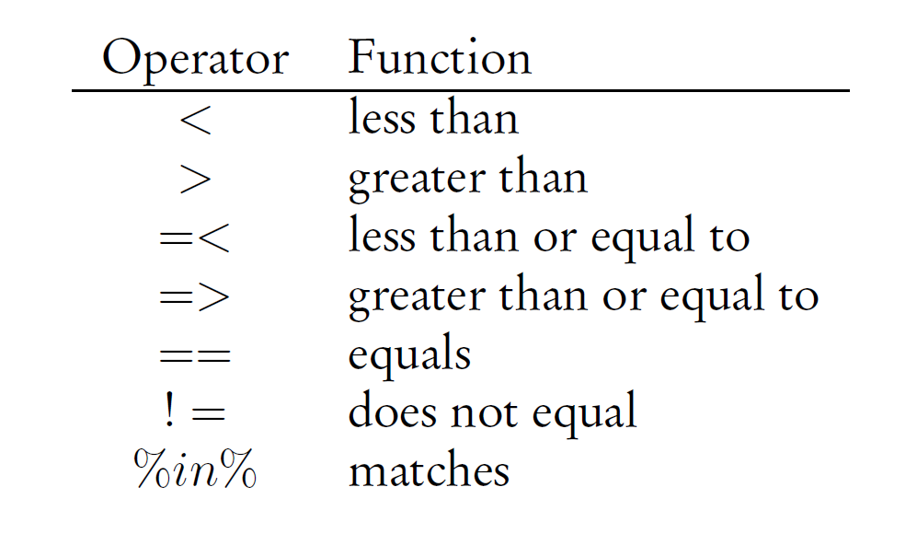
filter()

Slide 33
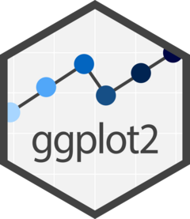
Data visualisation with

Slide 34
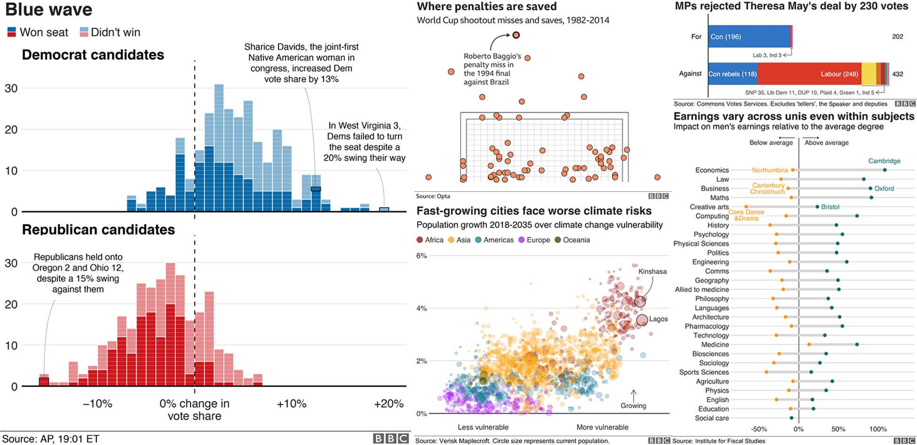
Data visualisation…
Visual representation of data.
Plots, charts, maps, infographics.
Accessible way to identify patterns, trends and problems in your data.
Indicates data quality and how it should be analysed.
Examples from the BBC (plotted in R!)
https://bbc.github.io/rcookbook/

Slide 35
The first step in any analysis is to PLOT YOUR DATA!

Slide 36



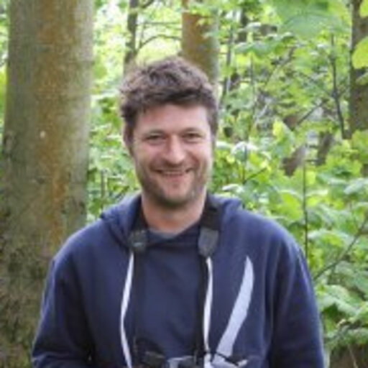
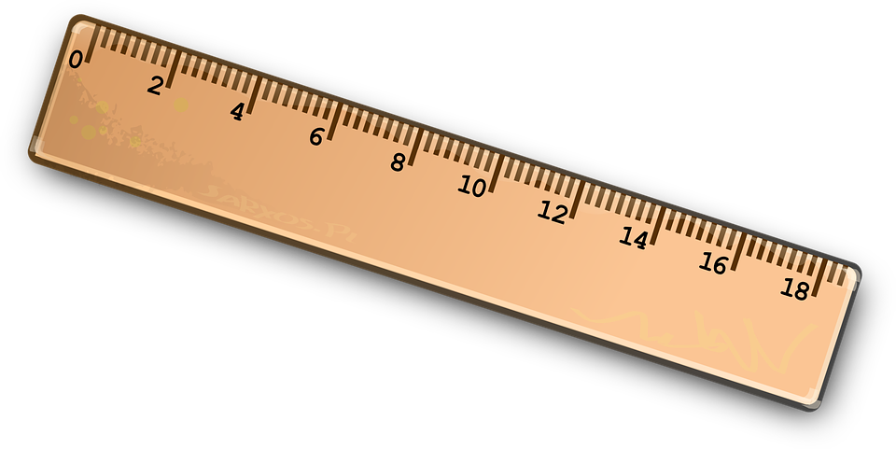
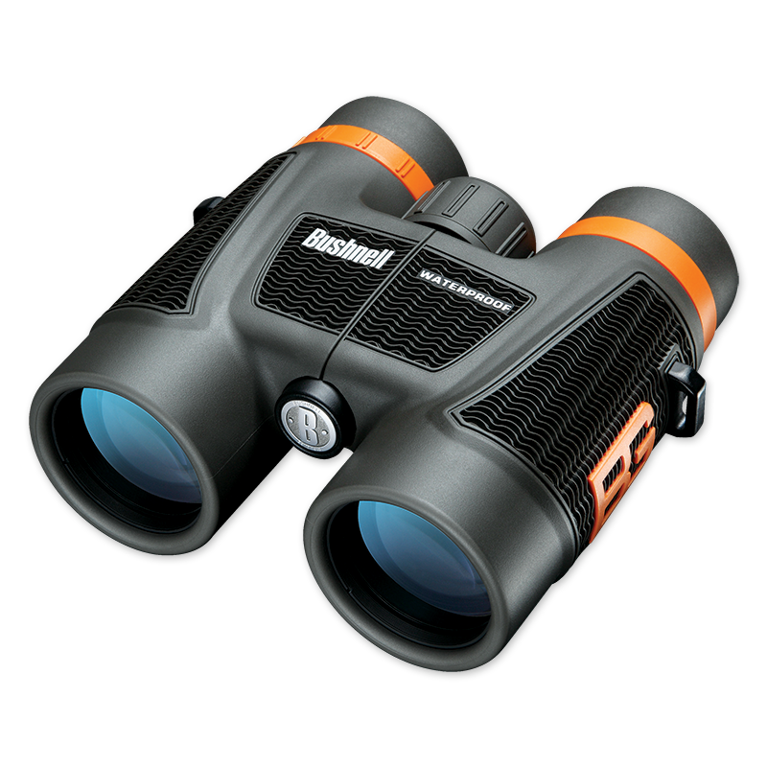

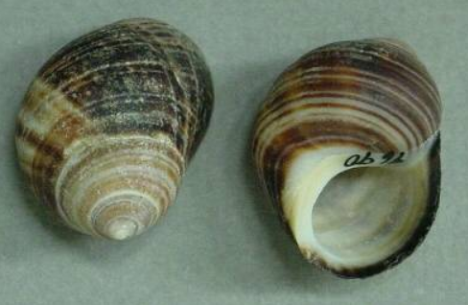
Do Littorina vary in size with shore height?
Notes:
So in another timeline when you would be out on Millport, you would be out collecting data in groups. You have a project and hypothesis in mind, and you have formulated a plan that will allow you to test your hypothesis in a rigourous and unbiased way. Here, we have assigned each other different tasks in collecting the data – Graham is the most resilient in the group, so he’s down measuring Littorina and getting battered by the waves; Per is the most organised, so he has the job of writing down the measurements, Tom and I are given the sacred job of levelling, leaving Nick, who is probably in the pub/getting arrested somewhere in Millport town. Now, given the fact that we formulated our hypotheses, it’s the case that you may have an expected pattern in the data in your head – but it’s not until you collect and visualise that data that you can begin to understand the answer.

Slide 37
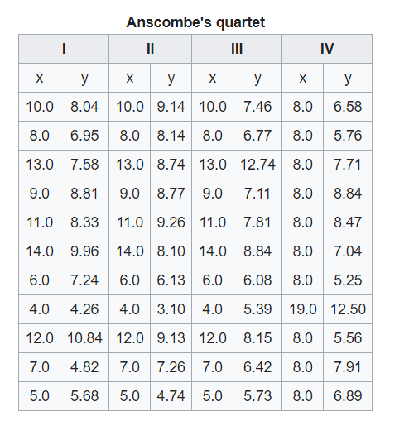
x = Height on the sea shore (m)
y = Shell size (mm)
Notes:
In our study, we collected four replicates. Here is an example of the first dataset we collected. By eyeballing the data, can anyone see any trend in the data?

Slide 38
x = Height on the sea shore (m)
y = Shell size (mm)
Notes:
We decided to replicate the dataset to see if we obtained similar conclusions – what do you think about this dataset?

Slide 39
x = Height on the sea shore (m)
y = Shell size (mm)
Notes:
How about this one?

Slide 40
x = Height on the sea shore (m)
y = Shell size (mm)
Notes:
And this one?

Slide 41
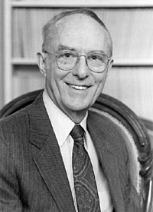
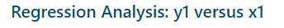
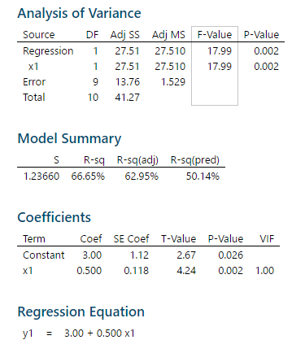
x = Height on the sea shore (m)
y = Shell size (mm)
Anscombe’s Quartet:
Notes:
So, it is possible to roughly interpret what’s going on without a visualisation, and it’s true that in these datasets, x is positively correlated with y. However, this dataset perhaps obviously, is not a true one for Littorina, but is actually one constructed in 1973 by the statistician Francis Anscombe to demonstrate both the importance of graphing data before analyzing it and the effect of outliers and other influential observations on statistical properties.
If you take this data and analyse it in Minitab, each of these datasets will give the exact same results – R2, slope and intercept.
But when you graph them, they tell quite a different story.

Slide 42
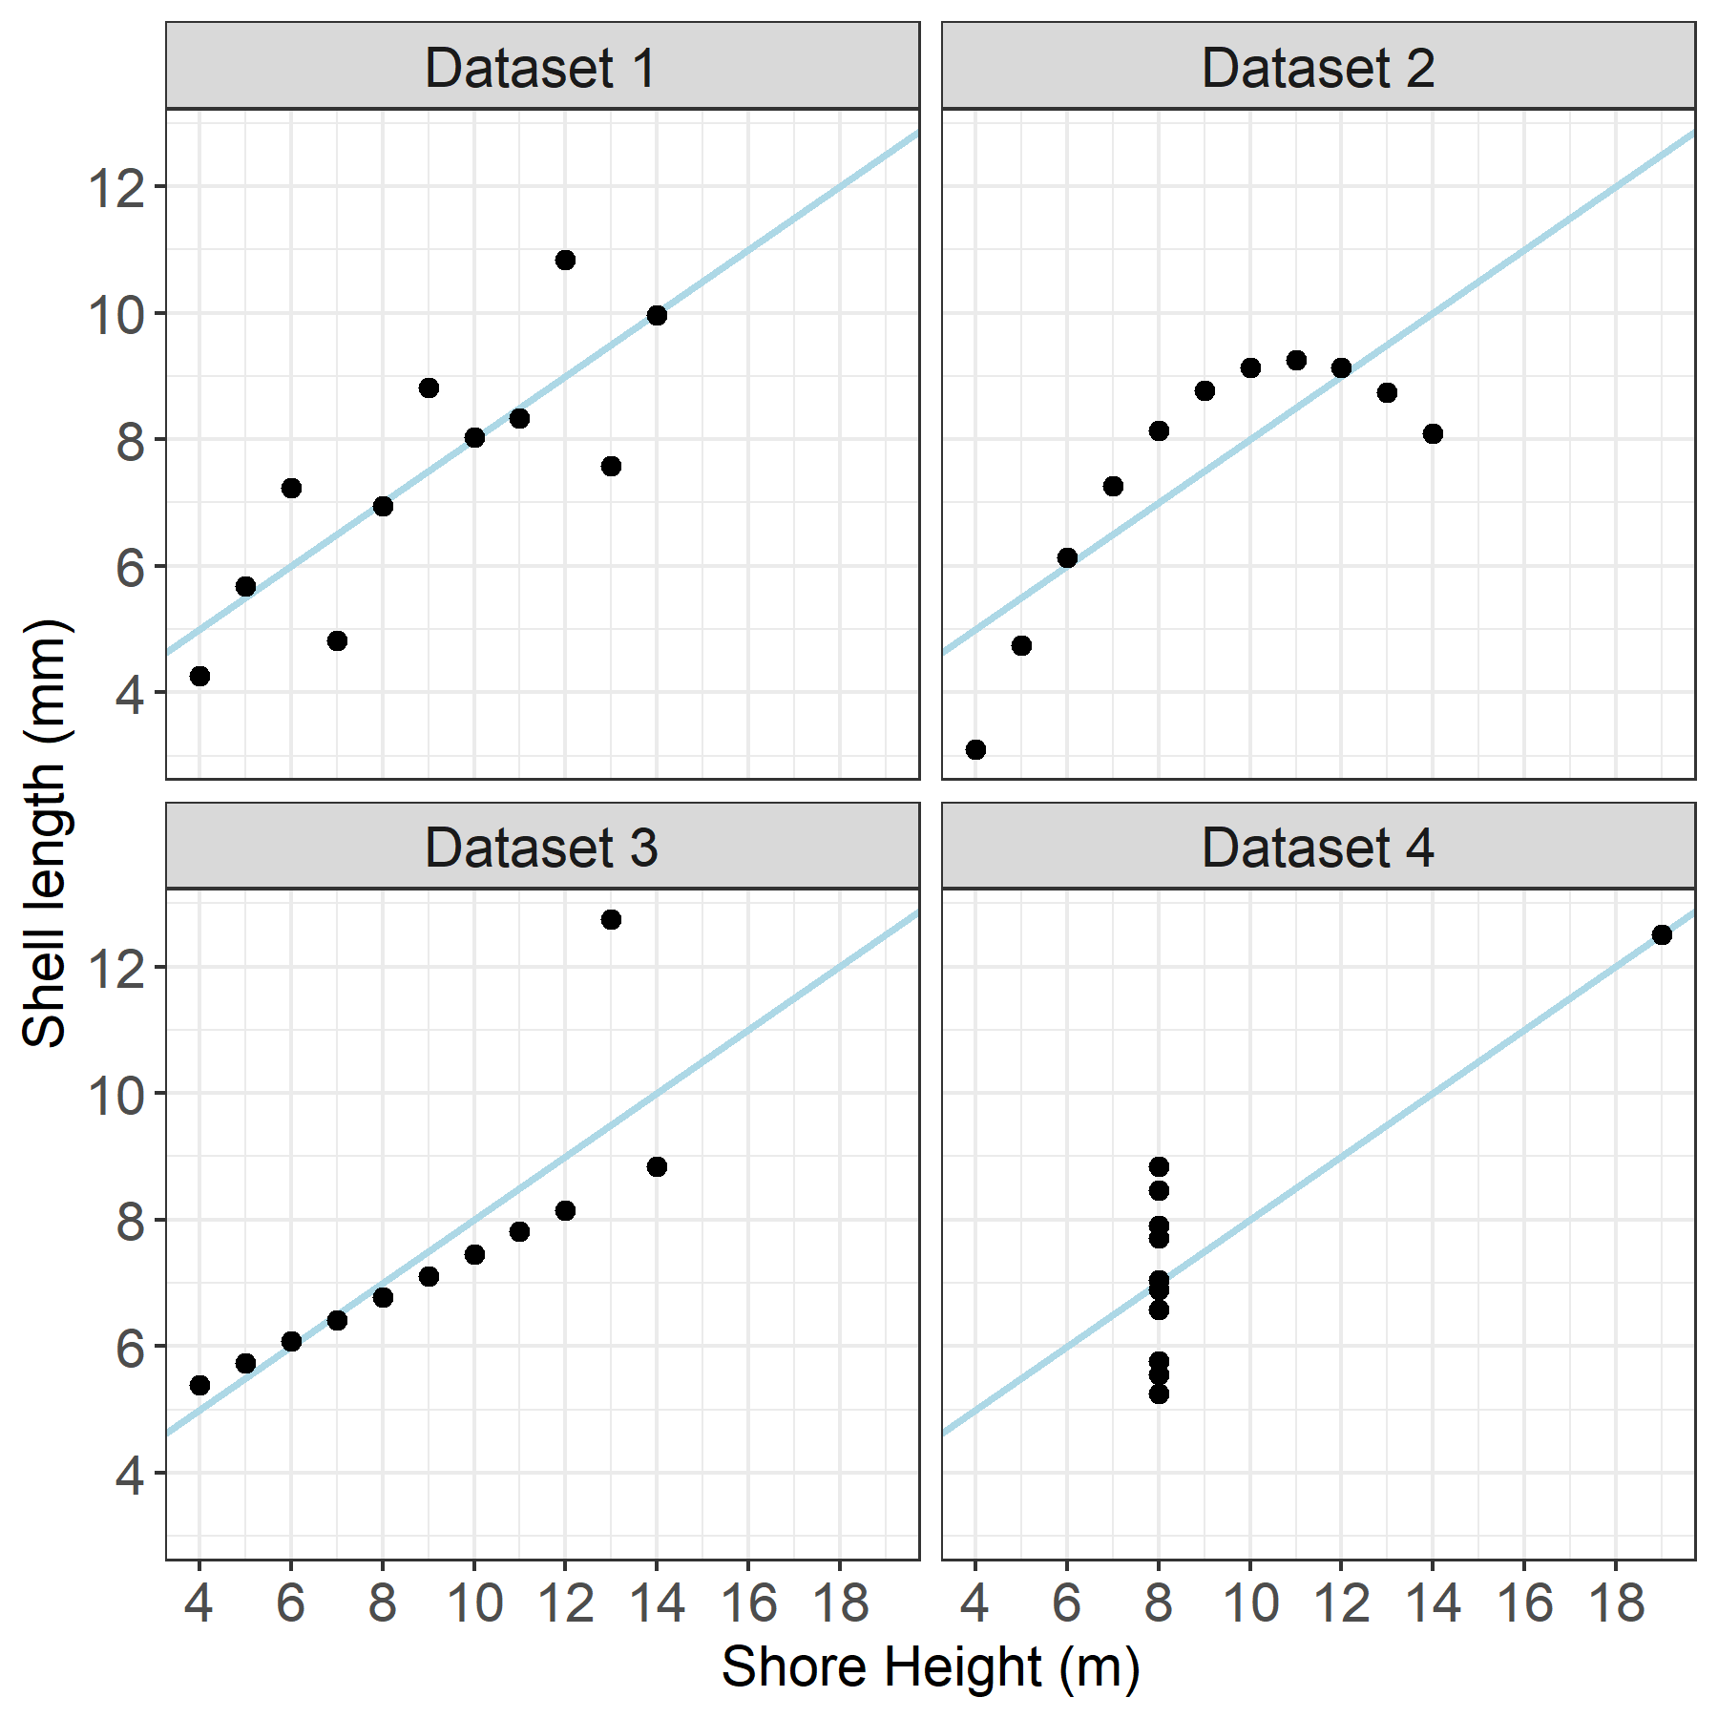
Notes:
So these are the four datasets, each with the linear regression line shown in blue.
What are people’s opinion on Dataset 1? Is a linear regression appropriate for the data? [The first scatter plot (top left) appears to be a simple linear relationship, corresponding to two variables correlated where y could be modelled as gaussian with mean linearly dependent on x.]
How about Dataset 2? [
Dataset 3 – what’s the problem, and how would you deal with it? [In the third graph (bottom left), the distribution is linear, but should have a different regression line (a robust regression would have been called for). The calculated regression is offset by the one outlier which exerts enough influence to lower the correlation coefficient from 1 to 0.816.]
Dataset 4 – what happened here? [Finally, the fourth graph (bottom right) shows an example when one high-leverage point is enough to produce a high correlation coefficient, even though the other data points do not indicate any relationship between the variables.]
This all highlights that you should plot your data before you begin to analyse it.

Slide 43
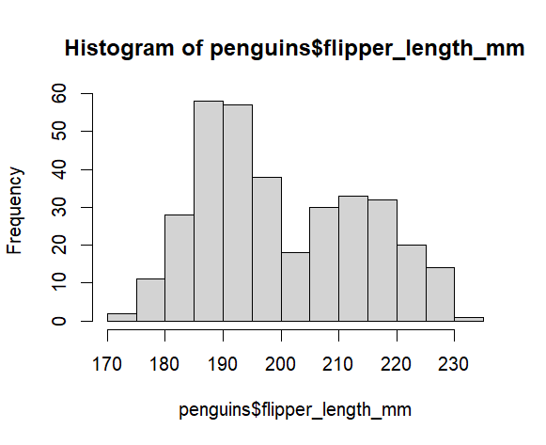
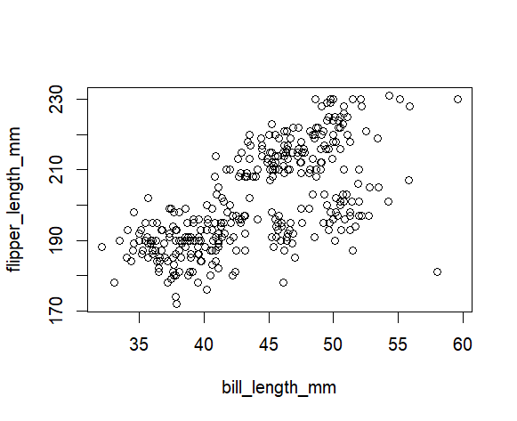
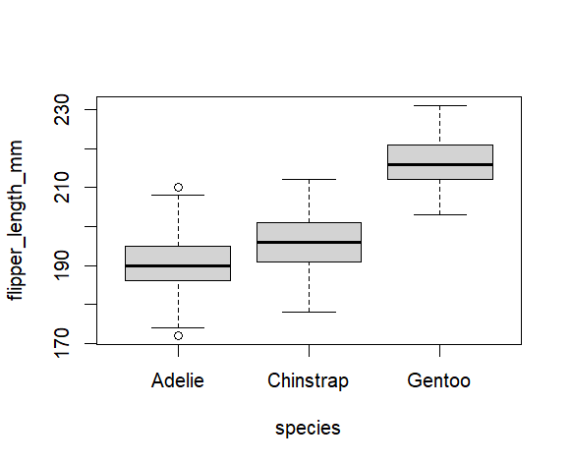
R has its own base graphics.
library(palmerpenguins)
# histogram
hist(penguins$flipper_length_mm)
# scatterplot
plot(flipper_length_mm ~ bill_length_mm,
data = penguins)
# boxplot
boxplot(flipper_length_mm ~ species,
data = penguins)
Tutorial at: http://rpubs.com/SusanEJohnston/7953

Slide 44
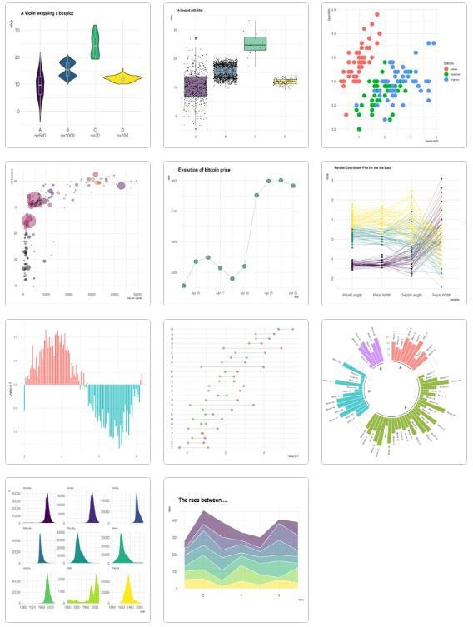
Data visualization with ggplot2
“You provide the data, tell ggplot2 how to map variables to aesthetics* what [graph type] to use, and it takes care of the details.”
*visual properties of your dataset
https://ggplot2.tidyverse.org/index.html
Source: R Graph Gallery

Slide 45




ggplot2 builds a graph with the following:
ggplot()
Data with aesthetic (visual) properties (`aes()`).
geom_...()
The type of plot (line, point, box-plot, etc.)
stat_...()
Statistical transformations (regression lines, smoothers, etc)*
theme()
How do you want your graph to look?
Other customisations
e.g. facets, scales, zoom, etc.
Notes:
Layers: ggplot()
Data with aesthetic properties (aes())
Geoms: geom_...()
Type of plot (line, scatter, box-plot, etc).
Stats: stat_...()
Statistical transformations
NB. Most geoms have a default stat, so this is not always need.

